Slide 1
Customer Segmentation & Retention Analytics
PORTFOLIO CASE STUDY · FINANCIAL SERVICES
Segmenting 4,000 fictional retail-banking customers by relationship value and engagement, and finding the early signs that they are about to leave
Ahsan Anas · October 2026
All customers, data and results are synthetic. Built with AI assistance (Claude) under the author's direction – see README.
Notes:
Portfolio case study. The dataset is generated from a seeded simulation – no real customer data is used anywhere.

Slide 2
Which customers create value, which are drifting away, and what should we do about it?
THE BUSINESS PROBLEM
A retail bank's customer book is rarely one market. High-value customers can be quietly disengaging, while highly engaged customers may hold only one product. Treating them all the same wastes retention budget and misses growth.
Generate
Seeded simulation of 4,000 fictional customers with linked behaviours, plus realistic data errors
1
2
Clean & validate
14 logged checks; nothing imputed; 39/39 automated checks pass
Questions this project answers
Who are our customer segments, and how much value does each hold?
Which behaviours separate engaged from drifting customers?
Which warning signals predict attrition – and how much revenue is at risk?
Which interventions are worth testing, and how would we test them?
3
Segment
Revenue proxy × Relationship Engagement Index → six actionable segments, stress-tested
4
Retain & grow
Warning signals, an attrition model, sized hypothetical interventions and a pilot design
Labels used throughout:
SYNTHETIC OBSERVATION
MODEL ASSUMPTION
HYPOTHETICAL
Notes:
Synthetic observation = what the fictional data shows. Model assumption = a modelling choice that could reasonably differ. Hypothetical = an intervention scenario, not a result.

Slide 3
4,085 raw rows became 4,000 clean customer records – and no value was invented
DATASET AND DATA CLEANING
4,000
fictional customers, 39 fields: demographics, balances, products, transactions, digital, service
Issue found | Rows | Action
Exact duplicates + re-ingested older snapshots | 85 | Removed duplicates; kept each customer's newest record
Region / employment coding variants | 125 | Standardised ('METRO', 'Metropolitan' → Metro)
Mixed date formats (DD/MM/YYYY vs ISO) | 140 | Parsed each format explicitly – no guessing
Income recorded in thousands (e.g. 54.3) | 36 | ×1,000 unit fix, flagged
Impossible ages, sentinel tenure (−1), future dates | 40 | Set to missing and flagged
Missing income · card limit | 161 | Left missing – not imputed
Negative savings, stale product counts, 900% card use | 92 | 0 if no product else missing; recount from flags; set missing
14
logged cleaning checks catching every injected issue type (681 injected problems)
0
values imputed – blanks stay blank and scores use only the fields available
39/39
automated validation checks pass (reproducibility, integrity, calculations, Excel = Python)
Every rule is in reports/data_quality_log.csv and is checked against the generator's list of injected issues.
Notes:
The generator records every injected problem in a manifest, so cleaning can be tested against ground truth. The income check finds 36 of 38 injected unit errors because two of those rows were later blanked by the missing-income injection.

Slide 4
Two axes – what a customer is worth and how engaged they are – give six segments with a clear action each
SEGMENTATION MODEL
MODEL ASSUMPTION
Value axis: estimated annual revenue
Balances × illustrative margins (current account 2.5%, savings 1.2%, mortgage 1.1%, loans 4.5%, investments 0.75% fee) + card interchange. Bands: High ≥ $1,500 · Mid ≥ $400.
Affluent Drifters
Established Core
Premier Advocates
High value
Engagement axis: Relationship Engagement Index (0–100)
Recency 30 (halves every 30 days) · frequency 20 · digital 15 · product adoption 20 · loyalty 15. Bands: High ≥ 70 · Mid ≥ 50.
Light Touch
Established Core
Engaged Builders
Mid value
Stress-tested
Five alternative weightings keep 84–90% of customers in the same segment; value cut-offs ±20%: 93–94%; engagement cut-offs ±5 points: 79–80% – the engagement cut-off is the most sensitive choice. k-means finds little natural structure (silhouette 0.20–0.22; agreement ARI 0.18), so transparent rules were kept: each segment maps to an action.
Dormant & Low Value
Light Touch
Engaged Builders
Low value
Low engagement
Mid
High engagement
Rule table in src/config.py; rebuilt with live formulas in the Excel workings.
Notes:
Fixed cut-offs (not percentiles) mean a customer only changes segment when their own behaviour changes. Bands sit near the 70th and 30th percentile of this synthetic book.

Slide 5
Value is concentrated, and the costliest risk sits with wealthy customers who have gone quiet
KEY FINDINGS
SYNTHETIC OBSERVATION
Premier Advocates
14% of customers hold 42% of revenue; attrition only 2.2%. Protect and reward.
Affluent Drifters
4.6% of customers, 12% of revenue – median 162 days since a transaction and 28% attrition.
Engaged Builders
Most engaged (REI 76; 84% main bank) but median revenue only $687 – the cross-sell pool.
Light Touch + Dormant
41% of customers but 7% of revenue – low-cost digital servicing.
Notes:
All findings describe the synthetic book. Revenue is a proxy built from illustrative margin assumptions.

Slide 6
400 customers flagged as high risk; $533k of annual revenue is at risk (expected)
RETENTION WARNING SIGNALS
SYNTHETIC OBSERVATION
MODEL ASSUMPTION
0.81
test AUC – logistic regression on 9 engagement and value features, 30% held-out test set
3.8×
attrition rate in the top 10% of risk scores vs the average
34%
of revenue at risk sits with Affluent Drifters ($181k), 33% with Established Core
Read with care: the outcome was simulated from the same hidden traits as the features, so this proves the method, not real-world accuracy.
High card utilisation flags only 5 customers and adds no risk here – not every intuitive signal earns its place.
Notes:
Strongest coefficients: frequency, product adoption, main-bank status and deposit trend (protective); complaints (risk). 7 customers with a missing input are not scored rather than imputed.

Slide 7
Three interventions worth testing – sized on stated assumptions, then proven with a holdout pilot
RETENTION AND GROWTH OPPORTUNITIES
HYPOTHETICAL
Affluent Drifters
Engaged Builders
Light Touch
Relationship-manager re-engagement call + needs review
Targeted cross-sell of one savings or card product
Digital activation (app onboarding, e-statements, bill-pay set-up)
$45k
$10k
≈5
Expected annual revenue protected (USD)
Incremental annual revenue (USD)
Customers retained (expected)
Assumption: Outreach cuts their attrition probability by 25% (relative)
Assumption: 10% take up one product worth USD 180 a year
Assumption: 15% become regular app users; their model risk falls to that of current regular app users in the segment
Proposed pilot: random 50/50 treatment vs holdout
Cell | Treatment / holdout | Baseline | Smallest detectable change*
Affluent Drifters RM outreach | 91 / 91 | 28.4% | ±18.7 pts
Light Touch digital activation | 548 / 547 | 10.6% | ±5.2 pts
Engaged Builders cross-sell | 273 / 273 | 5.0% | ±5.2 pts
* 95% confidence, 80% power; indicative. The Affluent Drifters cell is small, so only a large effect would show – pool cells or run longer.
Notes:
Every number on this slide follows directly from its assumption. The pilot turns assumptions into measured effects before any budget is scaled.

Slide 8
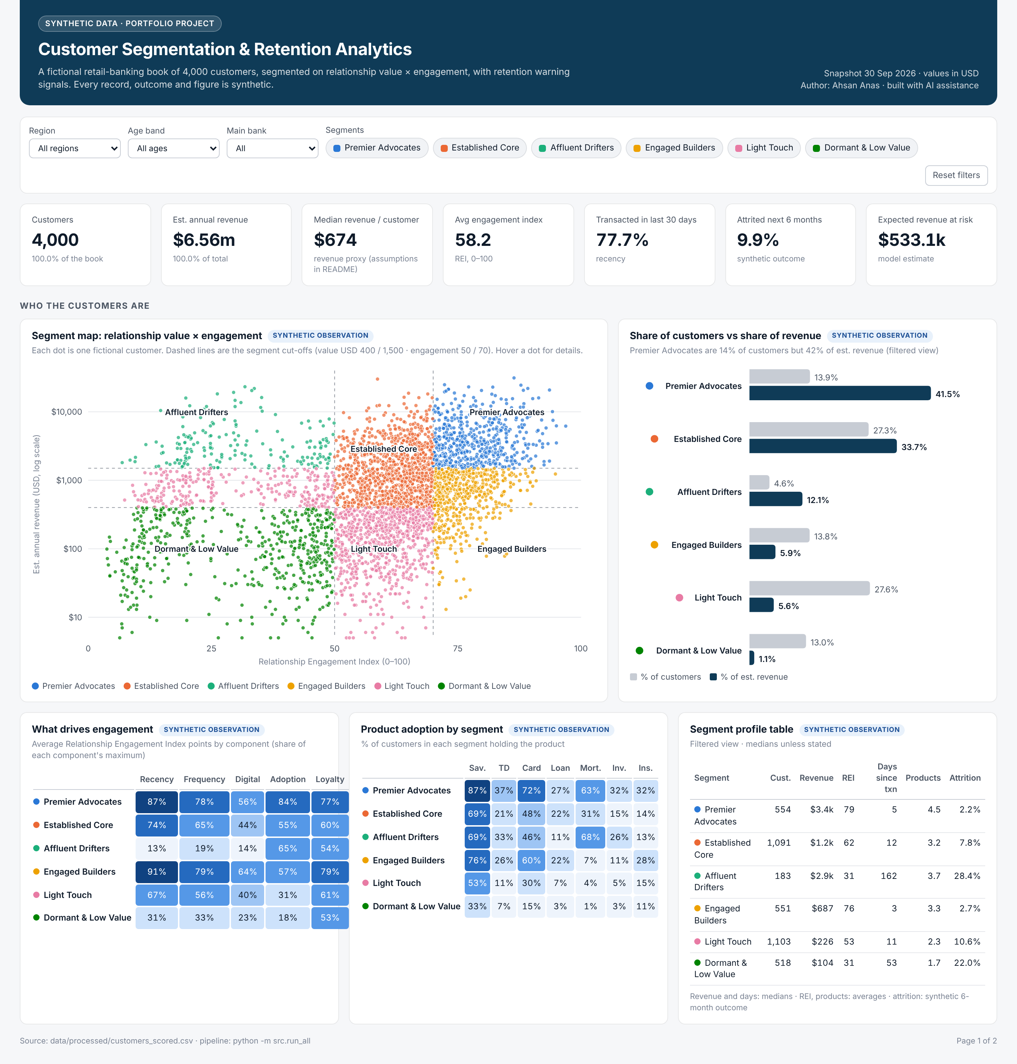
A reusable framework – to be validated on real, governed data before any decision
LIMITATIONS AND RECOMMENDATIONS
Limitations
Recommendations
Synthetic data: relationships exist because the generator created them
Revenue proxy relies on illustrative margins, not real pricing
Segment cut-offs are judgement calls (tested, but still choices)
Attrition model is associative, not causal; untested on real customers
Scenario values are assumption-driven, not forecasts
Re-run the pipeline on governed real data; recalibrate margins with Finance
Prioritise Affluent Drifters for relationship-manager outreach – via a holdout pilot
Use Engaged Builders as the cross-sell test pool
Monitor the four strongest warning signals monthly; re-fit the model on observed outcomes
Add fairness and privacy review before any model drives customer treatment
Interactive dashboard: dashboard/index.html (filters by region, age, main bank and segment)
About this project: designed and directed by Ahsan Anas; code, synthetic data and documents generated with AI assistance (Claude) and reviewed by the author. Reproduce everything with python -m src.run_all.
Notes:
Limitations are stated up front so the framework is credible: it demonstrates method on synthetic data.

